Slide 1
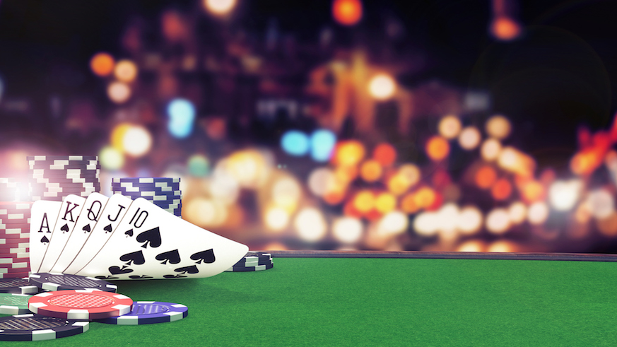
Probability in Poker
Jonathan Williams

Slide 2
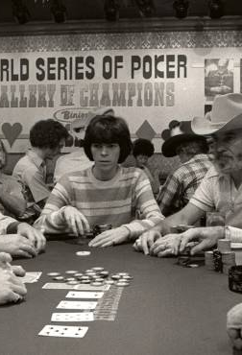
Quick History of Poker
Poker is an adapted version of the French game “Poque” which relied on 3 cards dealt and bluffing as key aspects of the game.
Brought over to heavily French settlements in America during the 1800s.
English speaking settlers adapted the name to “Poker.”
Eventually the game grew to include players having 5 cards for each player and by 1834, adopted the standard 52-card deck of today.

Slide 3
Basic Rules of Poker
Games used a standard 52-card deck (Sometimes with the addition of jokers).
Players are dealt cards and each gets a hand of 5 cards.
Scoring is dependent on the different matches and/or sequences of cards a player has in their hand. Certain hands are worth more than others.
Players go around and place bets based on their hand with the ability to bluff having a good hand.
They can:
“Call” – put the same number of chips
“Raise” – put in more than required amount of chips
“Fold” – puts no chips, discards their current hand, and is out until next dealing.

Slide 4
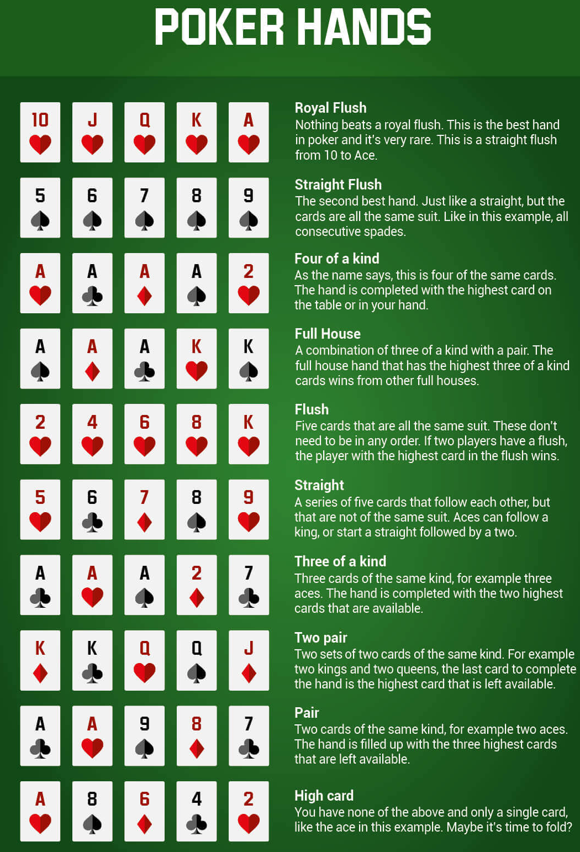
Different poker hands
With the assumption of playing with no wild cards, on the right are the different kinds of hands a player can have and ranked from best (top) to worst (bottom).
To begin to determine the probability of each hands we begin with finding the total number of possible hands using the combination method from chapter 7
C(52,5) = 52! / (5! * 47!) = 2,598,960 different total hands of 5 cards
For each type of hand we take the number of ways for each type of hand and divide by 2,598,960

Slide 5
Probability of Different basic poker hands
Royal Flush
Highest Rank. Made up of a ten, Jack, Queen, King, and Ace all of the same suit (all heart, spades, diamond, club)
Odds are: 4 / 2,598,960 = 0.000153908%
Straight Flush
Hand is in sequence and matching suit
Odds are: 0.00138517%
4 of a Kind
4 of the same card (ie: 4 jacks and any other card)
Odds are: 0.024%
Full House
3 of one kind of card with a pair of a different type
Odds are: 0.1441%
Flush
A hand with all matching suit
Odds are: 0.1965%

Slide 6
Probability of Different poker hands
Straight
5 cards that are in sequence but not matching types
Odds are: 0.3925%
3 of a Kind
3 cards of the same kind
Odds are: 2.1129%
2 pairs
2 sets of pairs (ie: 2 kings and 2 aces)
Odds are: 4.7539%
Single Pair
2 cards of the same kind
Odds are: 42.2569%
High Card (none of the above)
No matches – points based on highest single card in hand
Odds are: 50.1177%

Slide 7
Conclusion
The game of poker is a game of probability and knowing your odds to best maximize your profits. As we have seen the different hands possible can be extensive and only becomes more complicated as we account for more players and trying to calculate specific cards, not just hand types. Overall, this can be a fun and not so serious way of applying discrete math and statistics into real life.

Slide 8
Work Cited
Bourne, Murray. “Probability and Poker.” Interactive Mathematics, 2021, www.intmath.com/counting-probability/poker.php.
History.com Staff. “Where Did Poker Originate?” HISTORY, 23 Aug. 2018, www.history.com/news/where-did-poker-originate.

